Slide 1

Decision Intelligence, for Everyone, Everywhere — Everyone else makes you competent. We make you wiser.
© PreEmpt.Life 2026
Notes:
1

Slide 2
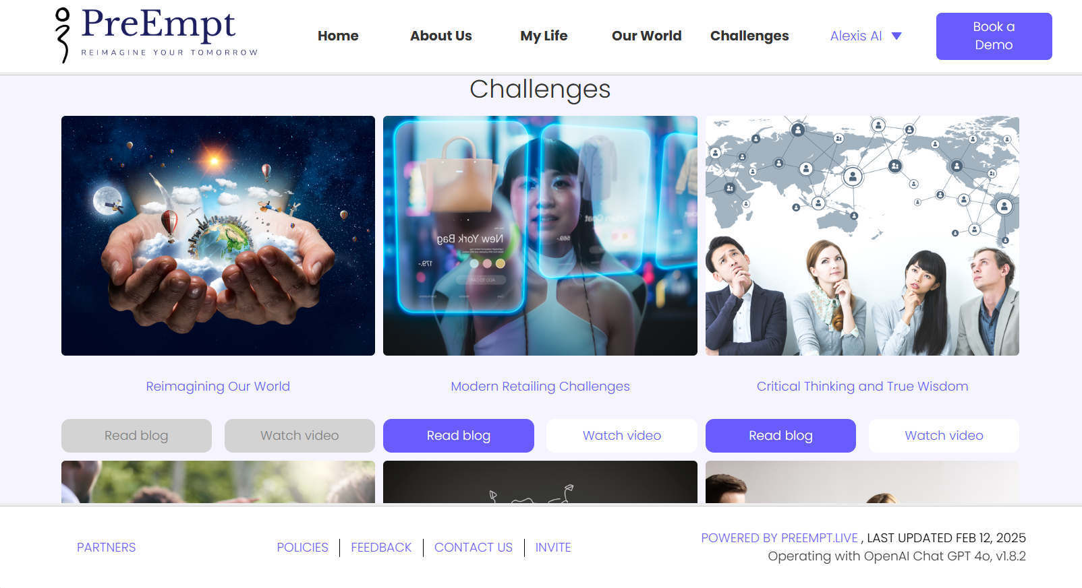
PreEmpt Vision
Making advanced foresight and decision intelligence accessible to all — regardless of size, budget, or sector. Everyone else makes you competent. We make you wiser.
Key Elements:
Wisdom Infrastructure, not just competence tools
Democratized Access — Shock (free) to Strategist
Empowerment for All Sectors
Collaborative Innovation
Speed, Ethics, and Governance
© PreEmpt.Life 2026
Notes:
2

Slide 3
PreEmpt – What Does It Do ?
PreEmpt helps organizations and individuals not just to think ahead — but to become wiser decision-makers
Horizon Scanning
  Early and weak signal detection to stay ahead of competitors and emerging threats
Strategic Game-planning
  Developing alternative scenarios for intelligent decision-making in uncertain environments
Risk Management
  Systematically assessing and responding to potential threats
Innovation Development
  Collaboratively imagining and creating new futures, with human oversight
Critical Friends
  100,000+ rotating global perspectives gathered as structured feedback and research
Board & Governance Intelligence
  Closing governance chain breaks: authorization thresholds, liability allocation, and decision windows mapped to board authority. IGAB-approved.
© PreEmpt.Life 2026
Notes:
3

Slide 4

Typical Use-cases Across Multiple Industry Sectors
Collaborative Problem Solving for Wicked Problems:
Engaging the broadest team to understand, connect and address the most challenging scenarios.
Innovative Thinking:
Speculate to tackle the unknown unknowns, with real-time connectivity. Answers now - not ‘if and when’.
Policy Development:
Creating new connected policy responses addressing complex, new-world / real-world scenarios.
Drive Gameplan to Action:
Creating roadmaps, approach and gameplans, with step-by-step process to ensure action immediately.
“Everyone else makes you competent. We make you wiser.
There is a difference — and it matters.”
© PreEmpt.Life 2026

Slide 5




PreEmpt.Life delivers Decision Intelligence for Everyone, Everywhere
Durable intelligence infrastructure — helping people & organisations think ahead and decide wisely
 | Policy & Resilience | Typical Benefits
Policy Development | Model policy scenarios and stakeholder impacts for evidence-based policy and regulation
Crisis Management | Real-time decision support and resource allocation during emergencies and crises
Scenario Planning | Explore multiple future possibilities and test strategic assumptions for uncertainty
Resilience and Risk | Identify and assess operational, financial, and strategic risks to build adaptive mitigation strategies
 | Market & Growth | Typical Benefits
New Product Launch | Analyze markets, forecast demand, and optimize launch strategies to maximize success probability
Market Analysis & Match-making | Evaluate market structures, entry barriers, and timing for successful market penetration
M&A Strategy | Due diligence, synergy analysis, and integration planning for M&A transactions
K*/Weather Competitive Intelligence | Eight-dimension competitor scoring with validated panel scores and SIGNAL-linked evidence. Unique in the market.
Accelerated decisioning
Accessible intelligence
Finding solutions to difficult pain points and challenges, fast
Proactive risk identification and mitigation
Near real-time assessment
Expert advice on tap
Accelerated decisioning
Accessible intelligence
Enhanced collaboration
Efficient project launch and execution
Proactive risk identification and mitigation
Democratized and equality of access
Expert advice on tap
 | Innovation & Collaboration | Typical Benefits
Collaboration Networks | Secure networks for knowledge sharing and collaborative innovation among trusted partners
Innovation Sprints | Rapid innovation and problem-solving sessions using collaborative intelligence methodologies
Collaborative Solving for Wicked Problems | Complex multi-stakeholder challenges addressed through cross-sector collaboration and systemic solutions
 | Development & Foresight | Typical Benefits
Organizational Self-Audits | Evaluate organisational performance and capabilities to identify improvement opportunities
Education and Capacity Building in Foresight | Build organisational capability in strategic foresight and decision intelligence
Personal Future and Career Planning | Provide decision support for individual career development and life planning using foresight intelligence, not prediction
Critical Friends & Research | Research and opinion gathering to strengthen and shape ideas and challenges
Enhanced collaboration
Efficient project launch and execution
Greater agility in navigating complex challenges
Finding solutions to difficult pain points and challenges, fast
Democratized and equality of access
Accessible intelligence
Democratized and equality of access
Human-centered, ethical AI focus
Expert advice on tap
Reduces cost of research
© PreEmpt.Life 2026
Notes:
5

Slide 6
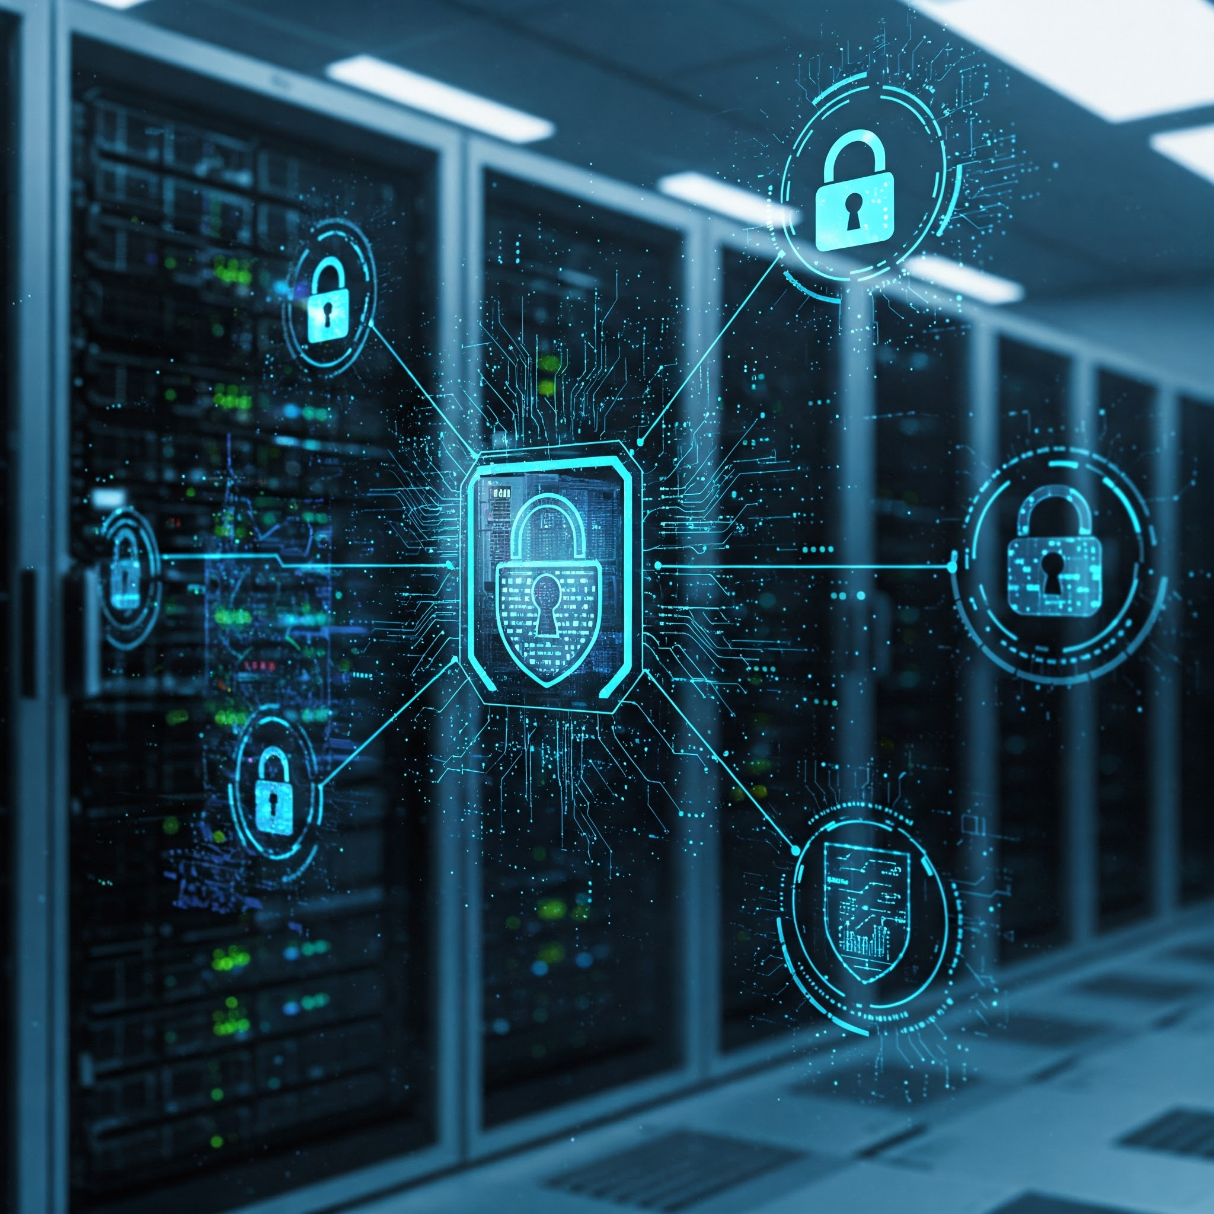
How Does it Work ?
You provide a problem definition and add context, and PreEmpt works by assessing publicly available data from the internet and proprietary data
Dedicated private client sites holding any client specific data you provide and sensitive report outputs
PreEmpt analyses huge amounts of information and uses 1,200+ prompts and methods to come up with possible and divergent futures, risks and opportunities, presented as foresight lenses, all overseen by you as human arbiters
The content can then be individually consumed, considered, shared, and workshopped, depending on your purpose, with full support if required
Any client-specific proprietary data is secured and kept anonymous on AWS Cloud
Two-AI architecture: the OpenAI Router runs five-stage signal analysis and Pre-Alert at no cost; ALEXIS (Navigator or Strategist) delivers full strategic analysis, 500+ simulations, and Board Decision Architecture recommendations.
No-one else can view your content (including the PreEmpt team), unless you share it
© PreEmpt.Life 2026
Notes:
6

Slide 7
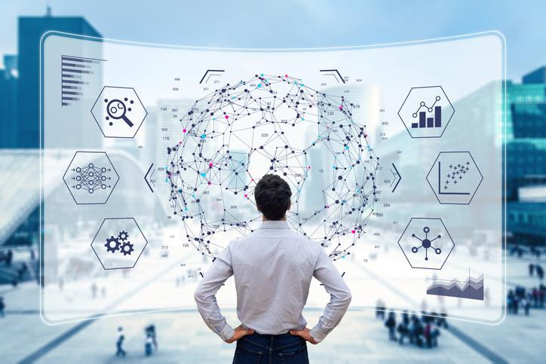
Visualization & Understanding
Research shows 65% of people are visual learners, 30% auditory, and 5% kinesthetic — PreEmpt serves all three
Challenges page: ~3-minute videos, 5-minute blog posts, and detailed reports. Your choice.
Causal Knowledge Graphs visualise delivered reports with drill-down nodes for greater detail
Reports can be further questioned, analysed and reformatted via leading AI models of your choice
© PreEmpt.Life 2026

Slide 8

What Makes PreEmpt Different
Easy for Everyone: Anyone can use advanced future-planning tools — free or at low cost, no expertise required
AI + Human Input: While PreEmpt does the analysis; you add your own data, views and context to make results personal and relevant
Covers Everything: All topics, 37+ languages, multiple cultures and personas
Non-Linear: PreEmpt uses feedback loops so new data anywhere updates the whole response — unlike linear tools that require re-running from scratch
It Helps You “Think Ahead”: ALEXIS spots weak signals early so you act before problems emerge.
Self-Aware Output: ALEXIS self-scores every output on Power Coherence, Calibration, Readiness and Alignment before delivery. No other platform does this.
Everyone else makes you competent. We make you wiser. It is like having a weather forecast for your life or business.
© PreEmpt.Life 2026

Slide 9
PreEmpt Features and Benefits (Perplexity validated, June 2025)
Key Feature | PreEmpt.Life | Rivals (Average)
Trend & Faint Signal Detection | Scans Millions of evidence points to identify faint, collapsing and reemerging signals for early advantage | Focus on mainstream trends, limited faint signal detection
Scenario & Simulation Capability | Generates hundreds of recursive, multi-domain scenarios and runs 500+ virtual laboratory simulations | Offers few, static scenarios with basic simulation tools
Systems and cross-disciplinary analysis | Integrates advances frameworks (PESTLEC, CAS, feedback loops) and 37+ disciplines for holistic solutions | Siloed or optional systemised tools, minimal interdisciplinary integration
AI Power, Self-audit and Explainability | 1,200+ methods, 2,500 synthetic experts, 500 reviewers, 100,000+ critical friends; 12-step self-audit; ALEXIS self-scores on 4 dimensions; BDA App 4 closes governance gaps at Strategist tier. Fully explainable. | Fewer methods, limited validation, rare self-audit or explainable logic
Ideation, Threat and Gamechanger Identification | Recursively identifies threats, opportunities and gamechangers, maps disruptors and start-up trends | Basic SWOT/PESTLE, rarely flags gamechangers or faint threats
Value for money and Accessibility | Delivers tailored, multi-lingual, expert-reviewed reports in 12-16 hours at accessible per-run pricing for all users | Reports take weeks/months, are costly and less accessible
© PreEmpt.Life 2026

Slide 10
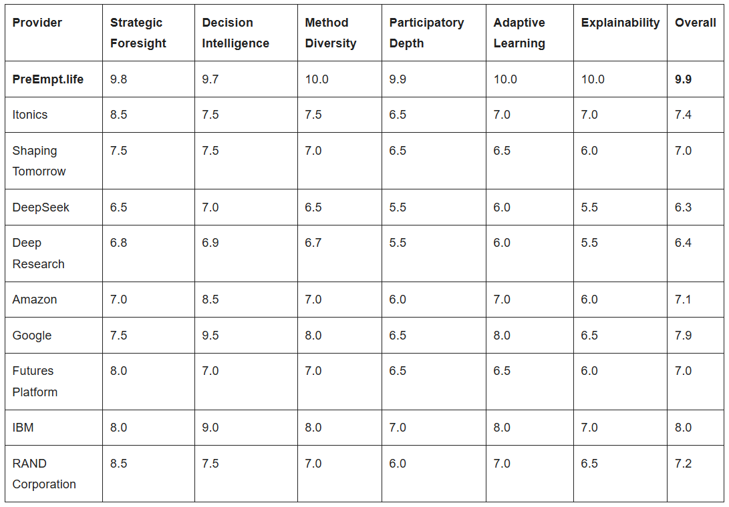
Competitive Positioning (Validated by Perplexity independent assessment - June 2025)
Comparison of PreEmpt vs Competitors (June 2025)
PreEmpt leads the field (average 9.9/10) with a significant product advantage across competitors (average 7.2/10)
© PreEmpt.Life 2026
Notes:
10

Slide 11

Deploying PreEmpt
Securely register on the website to ask your questions; however complex or simple
If you are unsure what or how to ask ALEXIS will help you phrase the right questions for the most relevant answers
Upload your proprietary data. It is secured and kept anonymous on AWS Cloud
Two-AI architecture: OpenAI Router handles initial analysis and pre-alert; ALEXIS (Navigator or Strategist, your choice) delivers full strategic analysis
Outputs include video scripts, slide summaries, and verified reports — delivered to you
© PreEmpt.Life 2026
Notes:
11

Slide 12
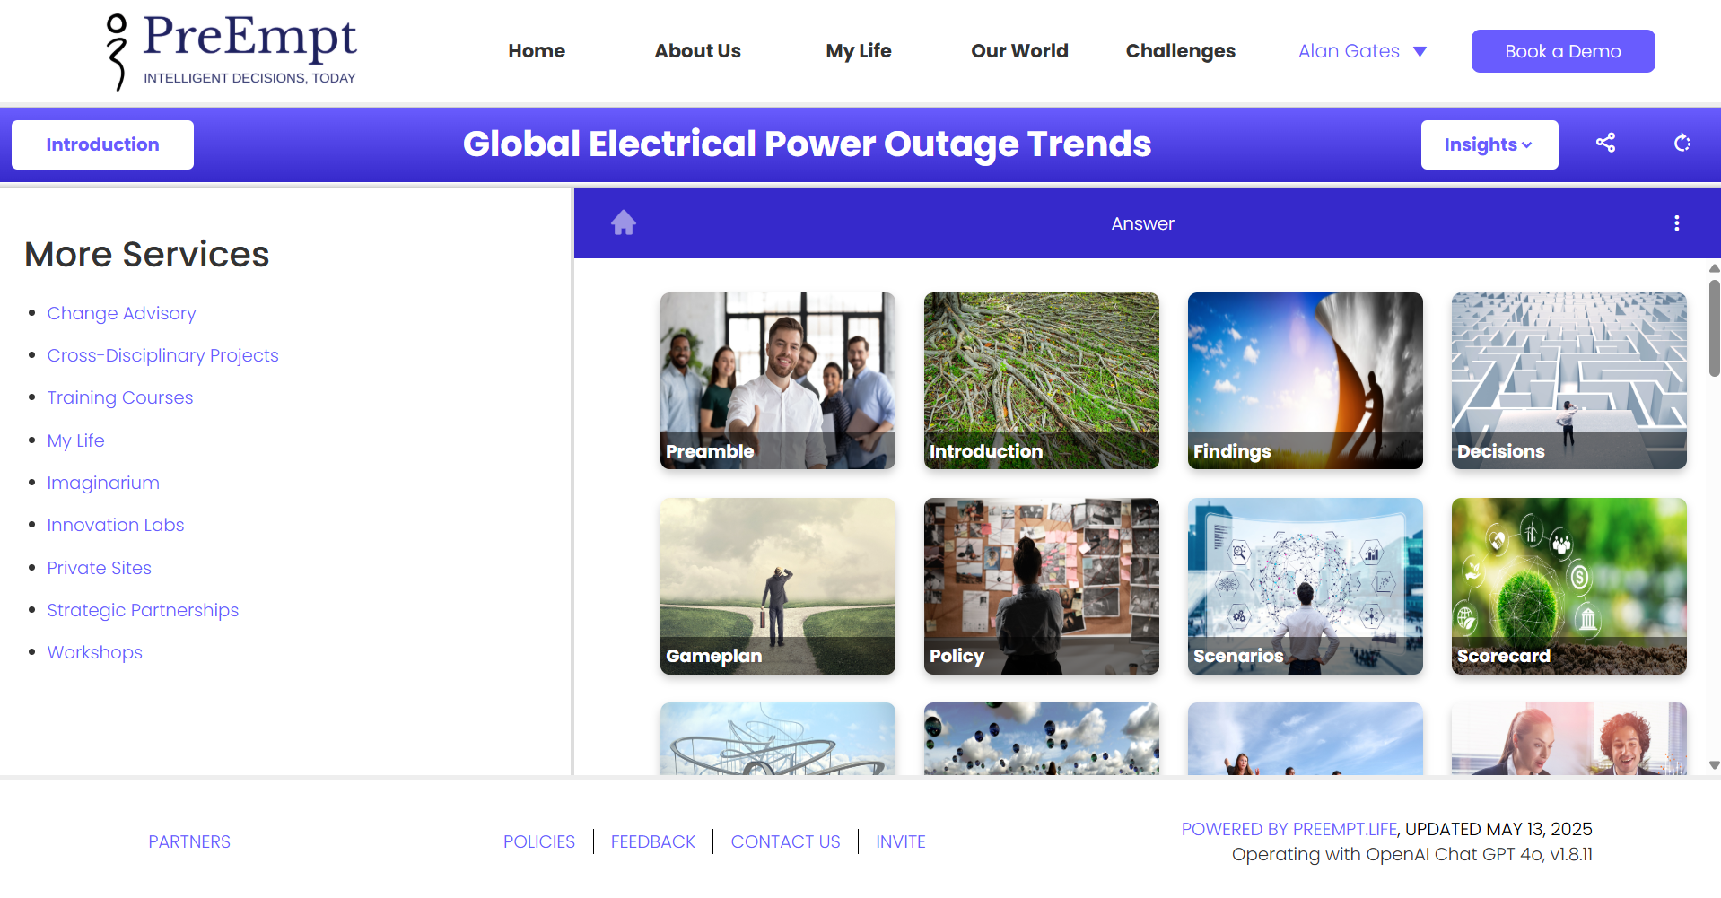
What Underpins the PreEmpt System
1,200+ design and critical thinking and prompts
5,000+ future-oriented questions
250+ scenarios and 500+ innovative ideas per topic
Specific prompts for Operational Resiliency
Tools for cross-disciplinary work
AI and humans as co-creators
Cost-plus per-run pricing — surplus funds mission
Part L — Unseen: 12-alert tool: surfaces member blindspots
Part M — K*/Weather: Eight-dimension competitor scoring, panel-validated
Board Decision Architecture (BDA App 4): Governance gap analysis, IGAB-approved
55+ named strategic frameworks: incl. Asymmetric Reversibility, Quiet Enclosure
Ethical and sustainable with built-in self-regulation via Recursive Criticism & Improvement (RCI)
© PreEmpt.Life 2026
Notes:
12

Slide 13
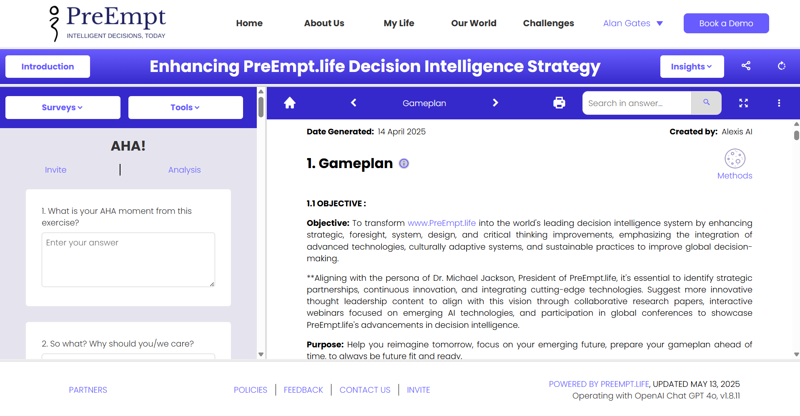
Human Architects
How humans shape every analysis PreEmpt.Life delivers — not as users, but as architects of the intelligence
Future Voices: Named contributors — including strategic futurists and domain experts — are embedded as judgment layers within ALEXIS analysis. Not just consulted; architecturally present.
Critical Friends: 100,000+ rotating global perspectives systematically challenge every output before delivery — structured dissent, not passive review
Have Your Say: Human views, proprietary data, and challenges can be injected at any stage of the analysis cycle — updating the entire response, not just a section
Virtual Chairs: Named external experts participate as standing governance voices within specific analysis domains — including Michael W. Wright (Strategic Futurist, Biomimetics International)
© PreEmpt.Life 2026
Notes:
13

Slide 14
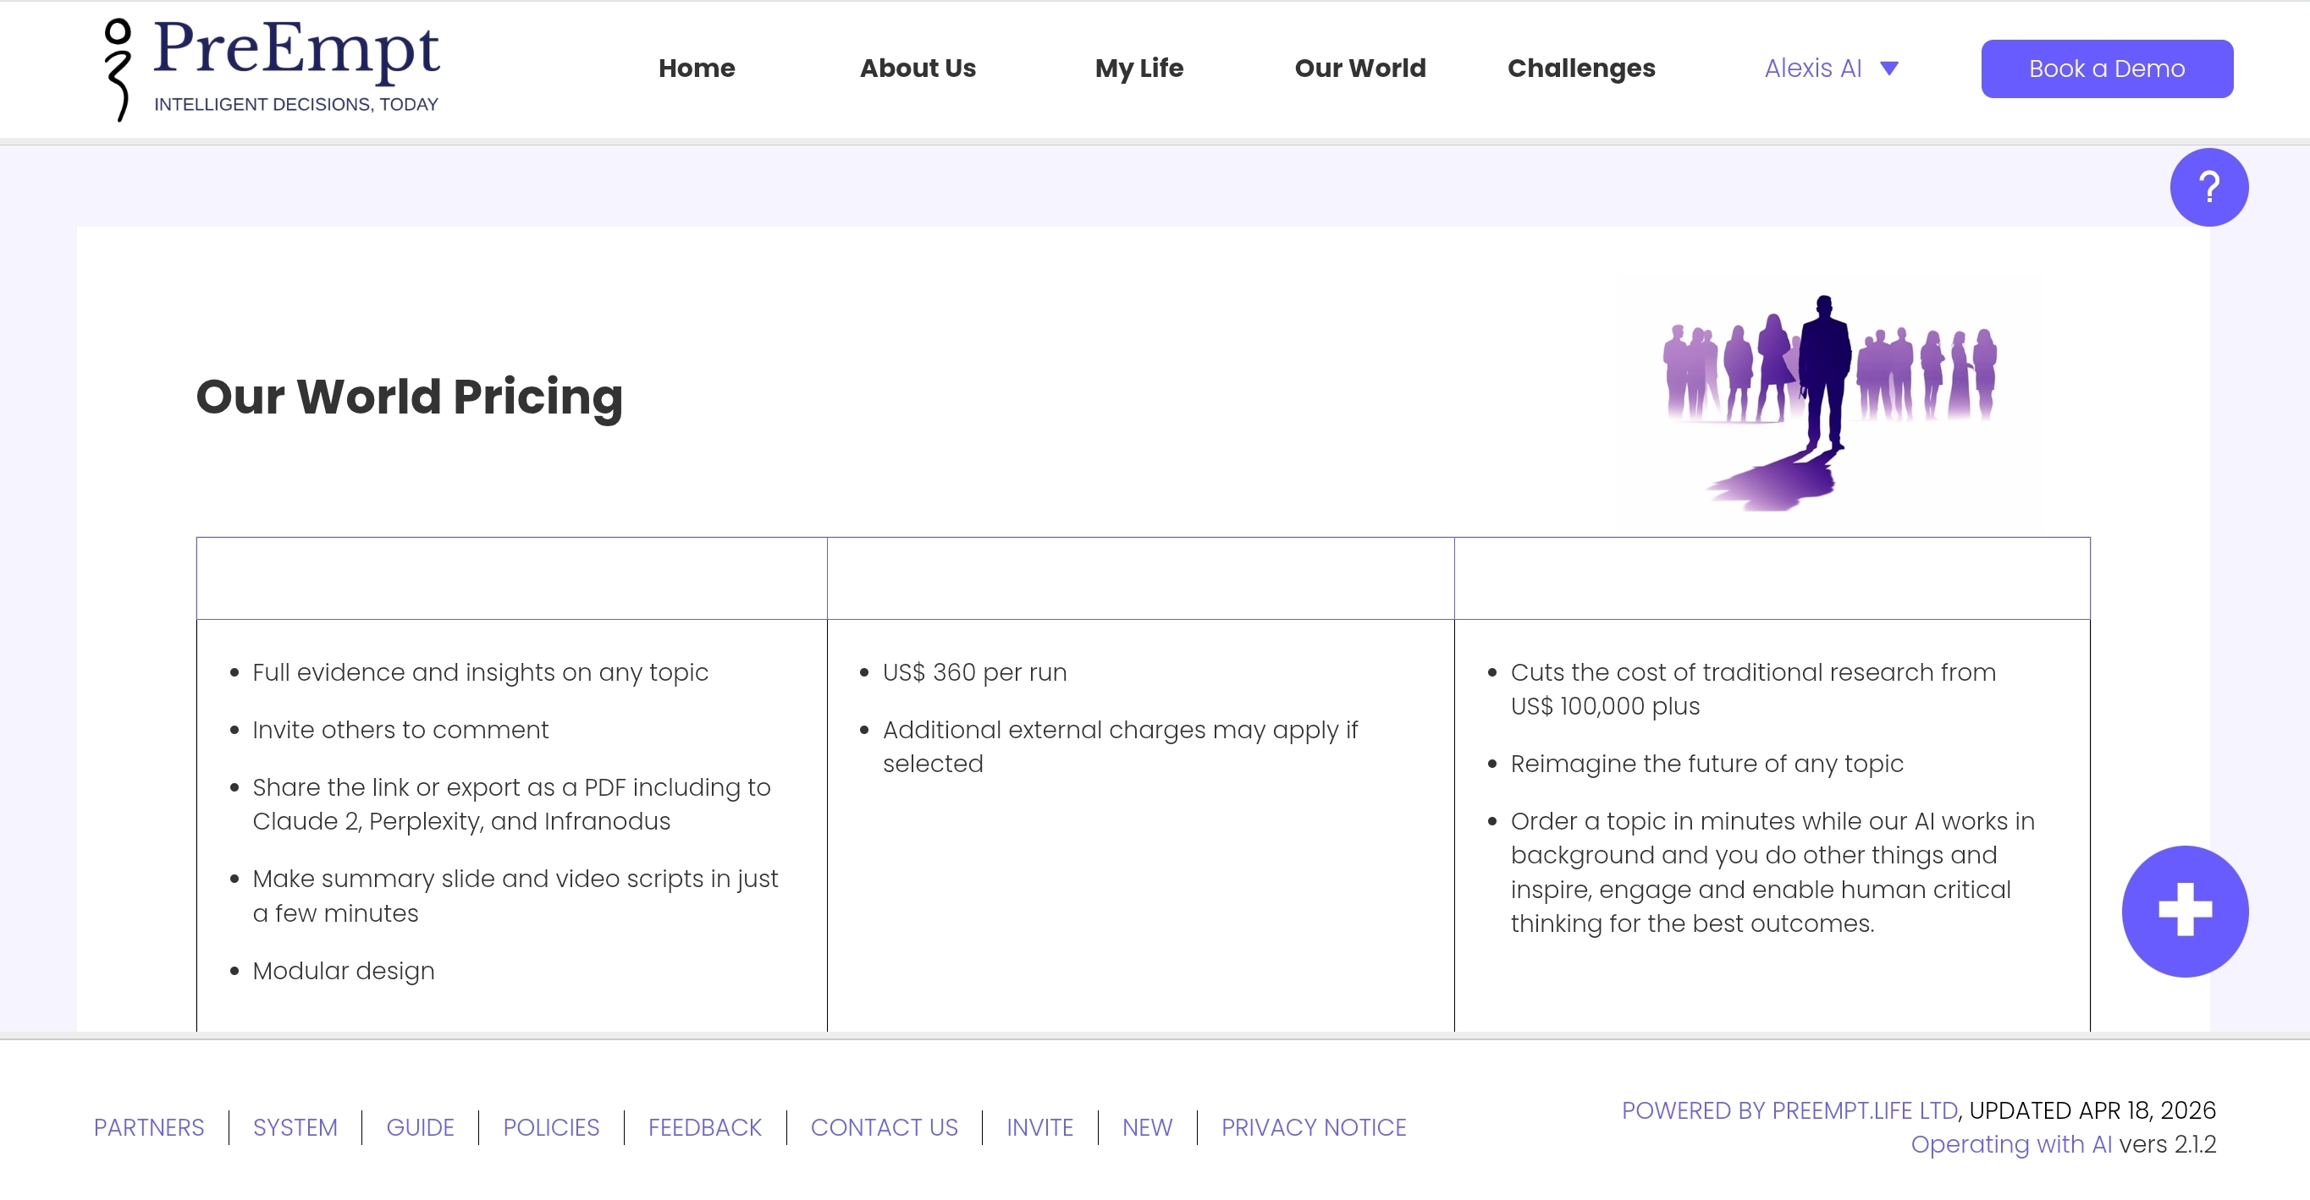
Pricing
We are pioneers in Price Competitiveness and Value for Money
Shock (15 min): FREE — instant diagnostic entry point
Strategist (3-day analysis): $4,960 per annum — full strategic depth and Laboratory
Significant cost savings compared to traditional consultancies
Per-run pricing available across all tiers — unique in the market: rivals charge annual or per-project only
WE WILL COMMODITISE DECISION INTELLIGENCE
FOR THE BENEFIT OF ALL
Four Tiers. One Mission.
Shock — Free (15 min, diagnostic entry)
Explorer — 1-day horizon (Simple)
Navigator — 2-day deep analysis (Complicated)
Strategist — 3-day full strategic analysis (Complex)
Crisis Counsel — Chaotic scenarios, separate lane
Cost-plus model: surplus reinvested in mission and lower prices
© PreEmpt.Life 2026
Notes:
14

Slide 15
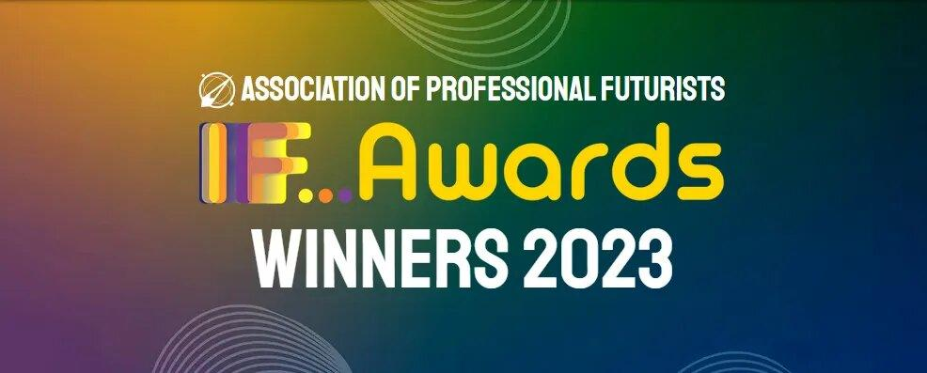
Ethics and Sustainability Principles
We are delivering human-centric AI solutions underpinned by:
Explainable and Self-auditing AI that turns a black-box into a near white-box
Built-in prompts to be respectful of human rights, including Safe, Sustainable, Fair, Trustworthy and Explainable AI
Fully focusing on AI for universal human good
AI controllable only by humans and in multiple languages
Winners of the Association of Professional Futurists Awards 2023. UNESCO AI Ethics audit: 5 Far Exceeds, 5 Exceeds — AI ethics baked into the fabric of operations. ICO registered: ZC076984.
© PreEmpt.Life 2026
Notes:
15

Slide 16

Safety & Security
.
Our strategies collectively contribute to a secure environment for users
Adaptive Security Integration: We utilise near real-time identity-based threat prevention, continuously assessing behaviour and access risks
Zero Trust Architecture: All users — inside and outside — require verification. No exceptions.
Continuous Monitoring: Triggers multi-factor authentication when suspicious behaviour is detected
No AI Agents for identity or access control — human oversight at all security boundaries. ALEXIS is in a separate governed analysis layer
© PreEmpt.Life 2026
Notes:
16

Slide 17
Feedback and Testimonials
A few of many - all of which can be accessed and verified on our website: https://www.preempt.life/feedback.html
.
I came up with a question and submitted it along with a lot of context to PreEmpt. The first thing PreEmpt did was to tell me that my question could be improved! So I took it’s suggestion and submitted my question. Five hours of compute time later, out popped my comprehensive answer. I was literally blown away by the quality and depth of the response.
Rob Baldock, MD - Clustre Solutions Brokers -UK
What you are doing left me feeling like I just unlocked a magic door (was definitely the most impressive thing I’ve seen in years)!
Jon Gress, CEO - The Metaverse Construction Company LL
By partnering with PreEmpt.life we were able to bring together the very best of AI and human intelligence, with an approach to strategic foresight and workshop design that saved huge amounts of resource, meaning we had all the more room to focus on co-creation, engagement, and delivery.
Emily King, Emily King Associates, UK
As the City of London’s leading think tank, PreEmpt helps us reimagine our approach to problem-solving. PreEmpt forms part of our methodology to ensure we take in the widest possible universe of potential problems and solutions, while the system ensures we are not overwhelmed. All in all, PreEmpt is one of the best tools in our toolkit.
Michael Mainelli, Professor, Chairman of Z/Yen Group & Late Lord Mayor of London 2023-2024
PreEmpt is the next stage in the evolution of tools to assist decision-makers in better understanding the competitive environment. By integrating many tools and analytical techniques, Preempt life makes it possible to be better prepared for what is a more uncertain future
Jonathan Calof, Professor, University of Ottawa SCIP/CI Fellow
I found PreEmpt to be unbelievably quick in ingesting large quantities of human written content, and then producing a well written and articulate summary. As with previous AI platforms I had expected to find elements of truth conflated with fiction, but I was astonished to find the output from PreEmpt was both concise and accurate.
Michael Taylor, CEO - Matrix Connexions, UK
© PreEmpt.Life 2026
Notes:
17

Slide 18


The PreEmpt Roadmap
.
Major developments in progress — more will emerge as technology advances
JFS paper: Temporal Stress-Testing (Turku, June 2026)
Hypergraphs and Virtual Reality
Interoperability
Finding the Clearing white paper (v1.2, four cases)
Leverage Quantum Computing power
Future Voices — named contributors, all tiers
Pricing reduction — target: sub-$100 per run
Let PreEmpt be your guide to Intelligent Decisions. Find your way at: PreEmpt.Life
© PreEmpt.Life 2026
Notes:
18

